Slide 1



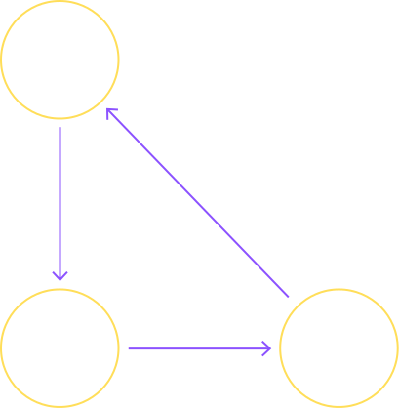
Machine Learning Project Report
Predicting Appliance Energy Consumption
Presented by: UTKARSH RAJ
Date: 25-06-2025

Slide 2
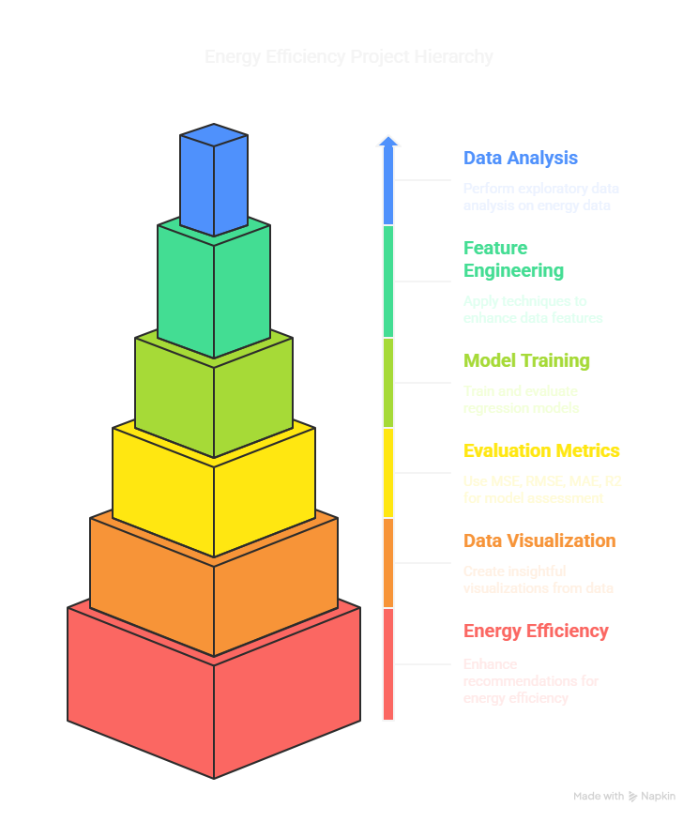
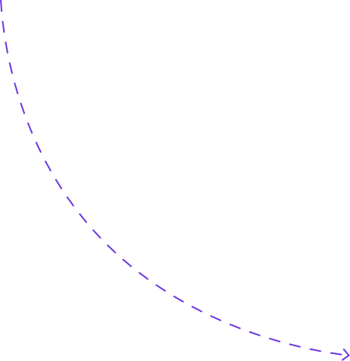
01
Project Objectives
Project Overview
Perform detailed Exploratory Data Analysis (EDA)
Apply feature engineering and scaling
Train and evaluate multiple regression models
Use evaluation metrics: MSE, RMSE, MAE, R²
Generate insightful data visualizations
02
Purpose:
Enhance energy efficiency recommendations
Assist smart grid management
Help consumers reduce energy bills
03
Dataset Details:
Source: energydata_complete.csv
19735 records, 29 features
Features include: temperature, humidity, visibility, dew point, weather conditions

Slide 3


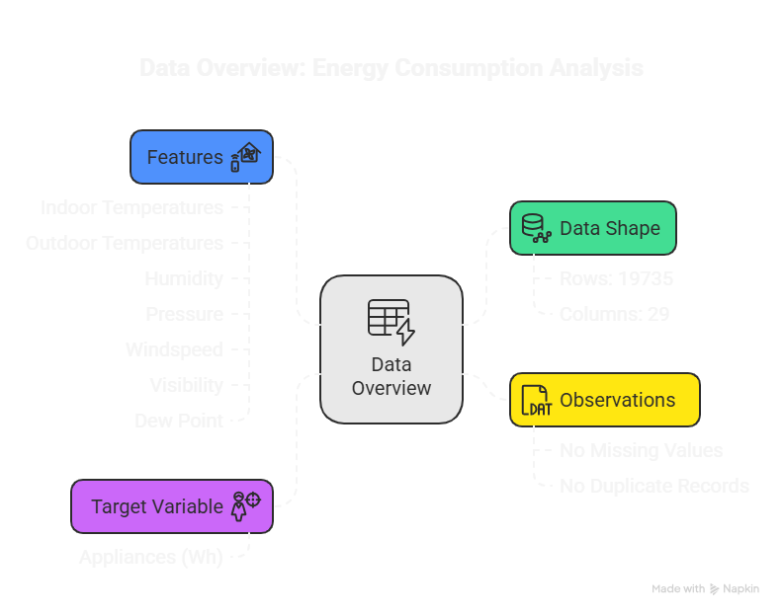
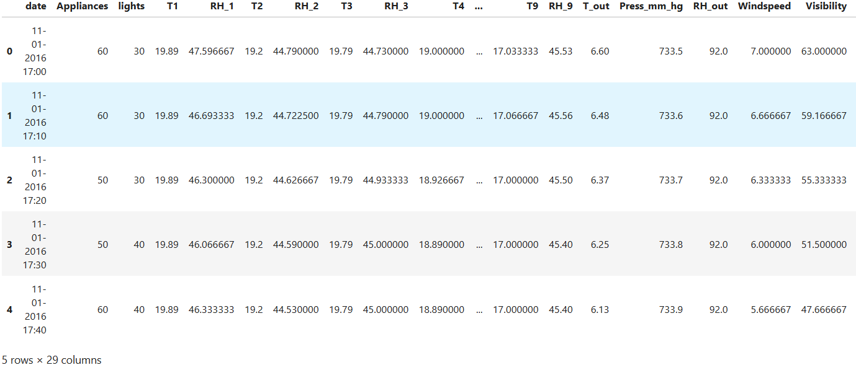
Data Overview

Slide 4
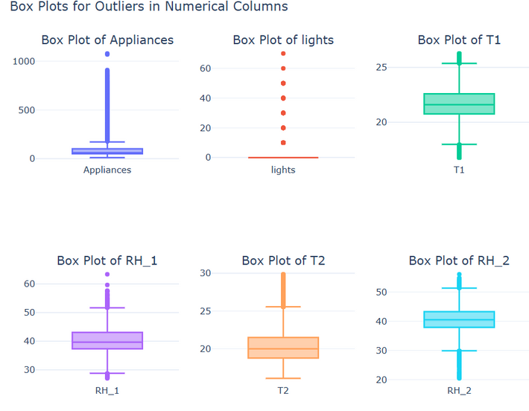

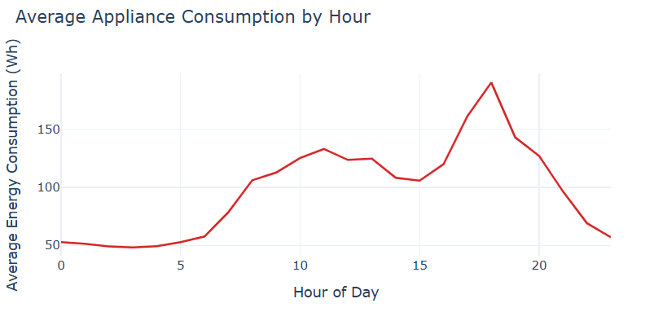
Exploratory Data Analysis (EDA)
DISTRIBUTION & OUTLIERS:
The Appliances target variable is right-skewed, with most values clustered below 200 Wh.
Significant outliers exist, with consumption occasionally exceeding 1000 Wh.
Box plot confirmed a wide IQR and high variance in energy usage patterns.
TEMPORAL PATTERNS:
Hourly Trends: Energy usage peaks between 6 PM to 8 PM, suggesting high evening activity.
Day of Week: Highest average consumption observed on Mondays and weekends.
Monthly Trends: Relatively stable usage between January to May — no clear seasonal spikes.

Slide 5
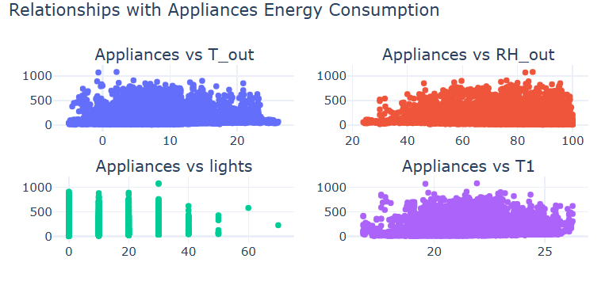
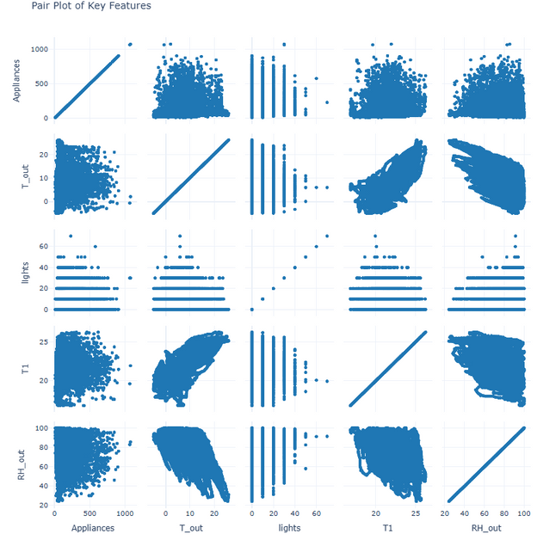
Exploratory Data Analysis (EDA)
FEATURE RELATIONSHIPS:
Weak correlations observed between energy consumption and individual features like:
Outdoor temperature (T_out)
Humidity (RH_out)
Indoor temperature (T1)
Lights (discrete, non-informative)
Scatter plots and pair plots indicate that no single variable dominates prediction — multiple interacting factors are likely influencing consumption.

Slide 6

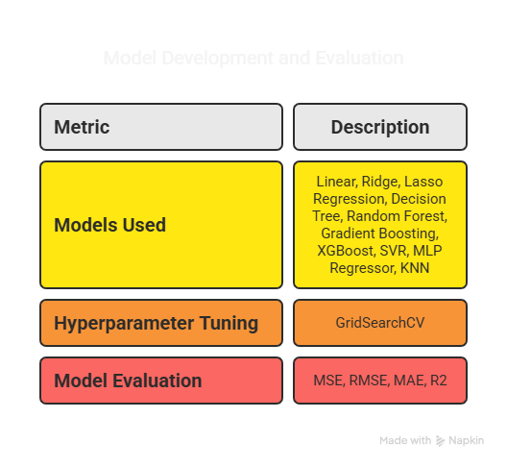
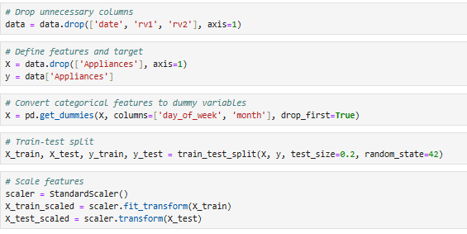
Data Preprocessing & Feature Engineering
Dropped unnecessary columns: date, rv1, rv2
Applied One-Hot Encoding: day_of_week, month
Performed Train-Test Split: 80%-20%
Applied StandardScaler for feature scaling
Final Feature Count: 36

Slide 7
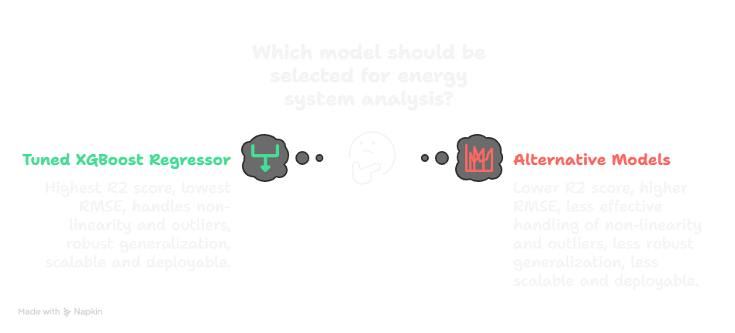
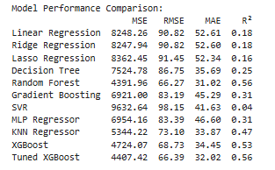
Model Performance Comparison & Best Model Selection
Best Model: Tuned XGBoost Regressor
Reasons for Selection:
Highest R² Score: 0.56
Lowest RMSE: 66.39 Wh
Effectively handles non-linearity & outliers
Robust generalization across unseen data
Scalable & deployable in real-time energy systems.

Slide 8
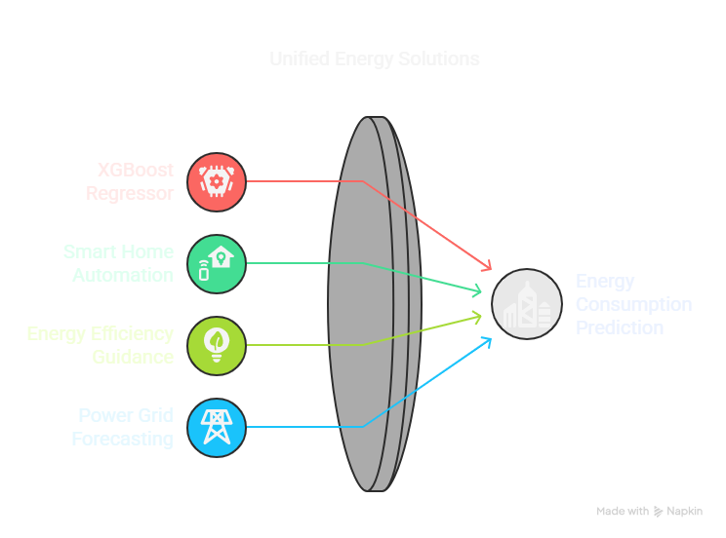
Conclusion
The project successfully developed a predictive pipeline for Appliance Energy Consumption using multiple regression models.
Among all the models tested, XGBoost Regressor (Tuned) proved to be the most robust and reliable — delivering the best generalization on unseen data. This aligns well with its reputation for handling non-linear relationships and feature interactions efficiently.
This predictive model holds strong potential for smart home systems, energy optimization, and power grid management, allowing stakeholders to anticipate and adjust energy loads in real time.

